Slide 1
HOSPITAL MANAGEMENT SYSTEM
EBEON1222710200 - Kalaimahal E
EBEON1222724679 - Subathra S
EBEON1222725218 - Santhiya S
EBEON1222708618 - Surya J
EBEON1222722743 - Sulochana S
Guided by
Varadharajan A

Slide 2
HOSPITAL MANAGEMENT SYSTEM
Login & registration
Login
Registration
SSO
Facebook & Google
E-mail Service
HomePage
About
Contact
Hospital Details

Slide 3
HOSPITAL MANAGEMENT SYSTEM
MODULES
✧ Login & Registration
✧ Homepage
✧ Admin
✧ User
✧ Doctor
✧ Appointment
✧ Chatbot

Slide 4
HOSPITAL MANAGEMENT SYSTEM
Chatbot
AIML
Web Socket
Responsive Bot
Appointment
Fixing Date & Time

Slide 5
HOSPITAL MANAGEMENT SYSTEM
Admin
Add Admin
Add Doctor
View Appointments
View Admin Details
View Patient Details
View Doctor Details

Slide 6
HOSPITAL MANAGEMENT SYSTEM
Doctor Module
View Appointments

Slide 7
HOSPITAL MANAGEMENT SYSTEM
LogIn & Registration:
In our project the Login & Registration is universal for all type of
users, they are Patients(users), Doctor & Admin.
But the Registration module or page is only for the Patients.First
the patients will have to register via the sign up.
And the also they can able to register via SSO.
Other than patient the doctor details or ther page will be added only by the admin.

Slide 8
HOSPITAL MANAGEMENT SYSTEM
Chatbot
In our project we use AIML for chatbot.
AIML based chatbots come under the rule-based chatbots category, however, some level of self-learning feature is feasible.
In the chatbot the patients(user) can able to ask their quries.

Slide 9
HOSPITAL MANAGEMENT SYSTEM
Appointment:
Here when the patient(user) are in the home page,there the
appointment option will be visible.
After tapping of appointment they need the fill the given details.
And finally submit the booking with the submit.

Slide 10
HOSPITAL MANAGEMENT SYSTEM
Admin
In our project admin control has the seperate dashbord,there
admin only can able to access.
There the admin can able to add doctor,add admins, view doctor details & user details and also can able to view the appointments and then also can able to edit the admin profile.

Slide 11
HOSPITAL MANAGEMENT SYSTEM
Doctor:
In our project doctor module can be able to view the
appointment details.

Slide 12
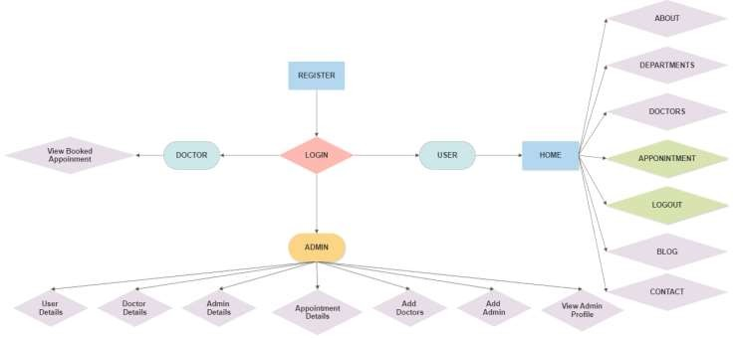
HOSPITAL MANAGEMENT SYSTEM
WorkFlow:

Slide 13
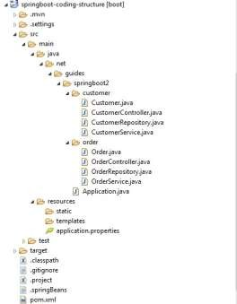
HOSPITAL MANAGEMENT SYSTEM
File Structure:

Slide 14
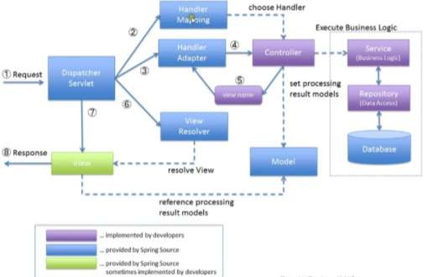
HOSPITAL MANAGEMENT SYSTEM

Slide 15
Challenging issues
Module Interconnection
Mapping issue
Integrating AIML with project
OAUTH configuration issue
Hibernate Issue

Slide 16
Testing
Test Senerios
Testing Document

Slide 17
Future enhancement
Online Patient Consultancy through video call
Online Pharmacy Store include home delivery

Slide 18
CONCLUTION
Here, I have come to the end of the project on the topic of Hospital Management System. I tried my best to include all the necessary points that are required related to the given topic.
And, here is our final submission of our Project
- Hospital Management System

